Slide 1
Threat Modeling and it’s Methodologies

Slide 2
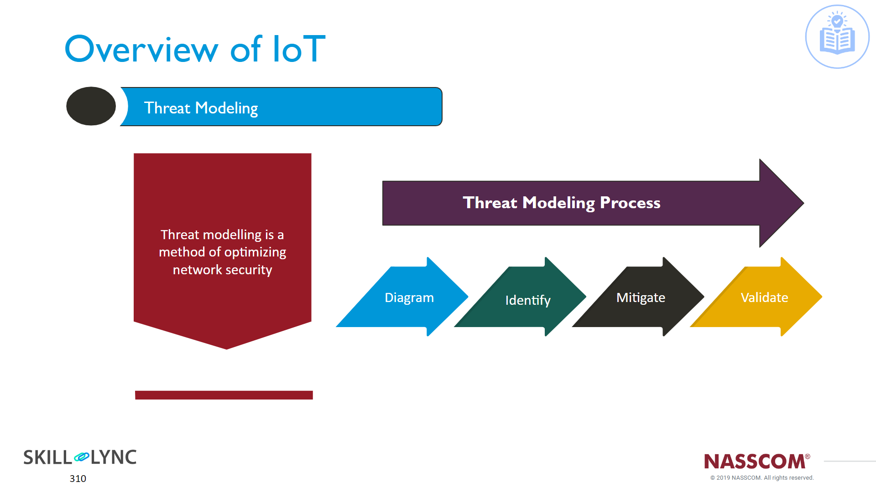
What is Threat Modeling :
It is defined as a “Method of Optimizing Network Security by Locating Vulnerabilities, Identifying Objectives and Developing Countermeasures to either Prevent or Mitigate the effects of Cyber-Attacks against the system”.

Slide 3
Process of Threat Modeling

Slide 4
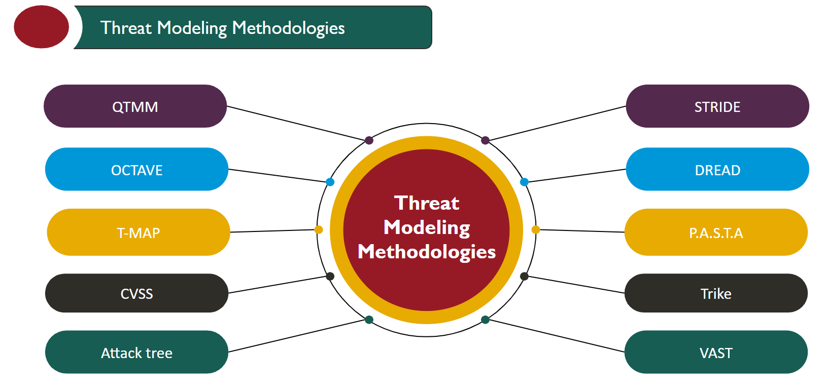
Different Threat Modeling Methodologies:

Slide 5
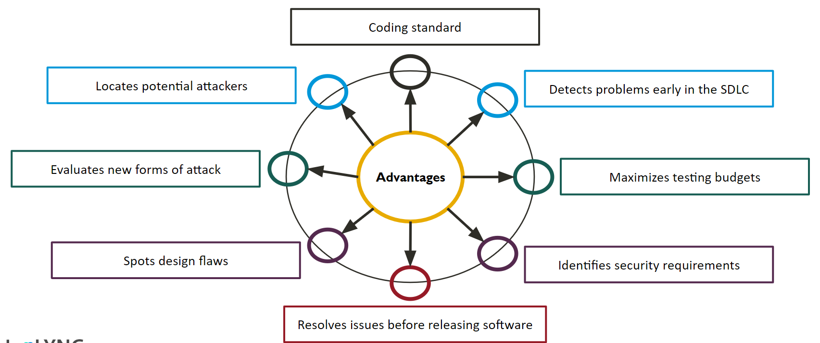
Advantages of Threat Modeling

